Slide 1
SCU CARPOOL
Group 2

Slide 2
Outline
Project Intro
Project Design
Demo

Slide 3
Project Intro
Two Actors
  Drivers publish routes
  Riders select routes
Two Directions
  Departure:SCU
  Destination:SCU
Three Regions
28 Stops

Slide 4
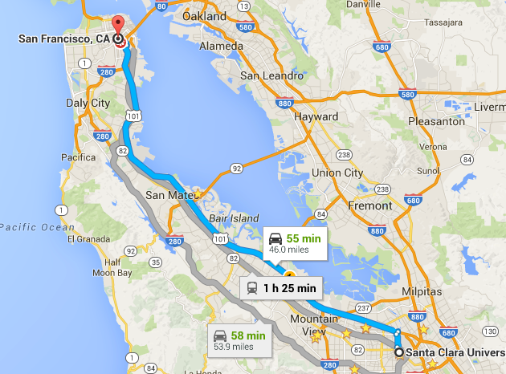
Carpool Routes
Insert map
San Francisco → SCU
SCU → San Francisco

Slide 5
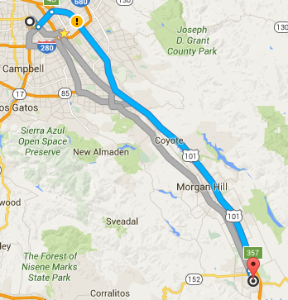
Carpool Routes
Gilroy → SCU
SCU → Gilroy

Slide 6
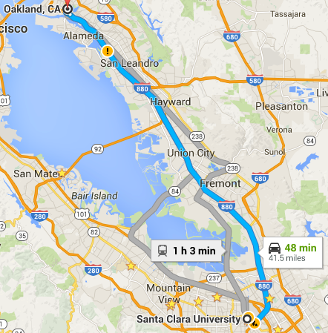
Carpool Routes
Oakland→ SCU
SCU→ Oakland

Slide 7
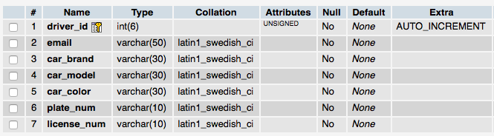
Database Design - Driver Table

Slide 8
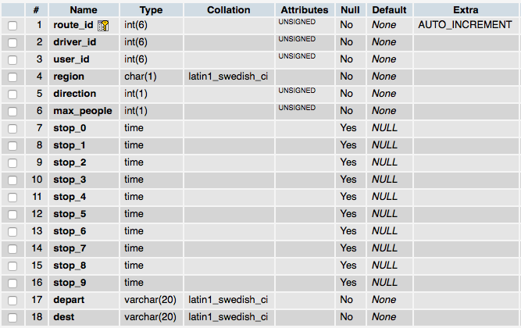
Database Design - Route Table

Slide 9
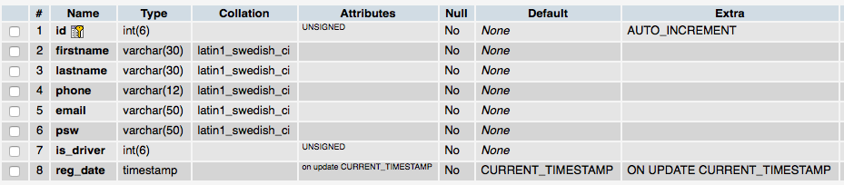
Database Design - User Table

Slide 10
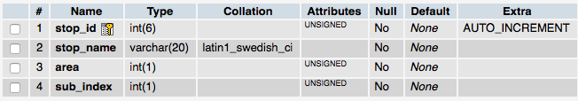
Database Design - Stop Table

Slide 11
Riders’ side
Drivers’ side
Sign up / Log in
Enter Departure & Destination
Select Ideal Selection Results for Carpool
Submit Carpool Request
Send an email to Driver automatically
Sign up/Log in
Publish Routes
Receive Carpool Request Email

Slide 12
DEMO

Slide 13
Thanks!

